Slide 1
Exploring the Mechanisms of Output Interference During Cued Recall Using Metamemory Judgments
Taylor Curley, PhD Air Force Research Laboratory taylor.curley@afrl.af.mil

Slide 2
Acknowledgements
I would like to thank several people, including:
Chris Hertzog (Georgia Tech)
Emily Lustig (Georgia Tech)
MacKenzie Hughes (Georgia Tech)
Rick Thomas (Georgia Tech)
John Dunlosky (Kent State)
Paul Verhaeghen (Georgia Tech)
Dobromir Rahnev (Georgia Tech)
Megan B. Morris (AFRL)
Leslie Blaha (AFRL)
Technical notes:
This project was part of a dissertation project at the Georgia Institute of Technology and funded in part by a Ruth L. Kirschstein National Research Service Award (NRSA) Institutional Research Training Grant (T32) from the National Institutes of Health (National Institute on Aging) Grant 5T32AG000175.
All code and figures were run using Julia and R, and this presentation was compiled using Quarto.
Most analyses can be found on OSF: osf.io/2eqv7.
Notes:
These are optional notes.

Slide 3
OVERVIEW
Two questions:
What are the mechanisms that underlie output interference?
What can metamemory judgments tell us about potential mechanisms of memory retrieval and interference?

Slide 4
Memory Interference
Long-term memory retrieval is often affected by competing information.
Commonly called memory interference.
Most interference effects show increases in errors in which people recall the wrong item, or errors of commission.
e.g., Tulving & Watkins (1974)
One implication is that memory interference states stem from similar operations; however, some interference states are different than others.
e.g., output interference.
Notes:
These are optional notes.

Slide 5
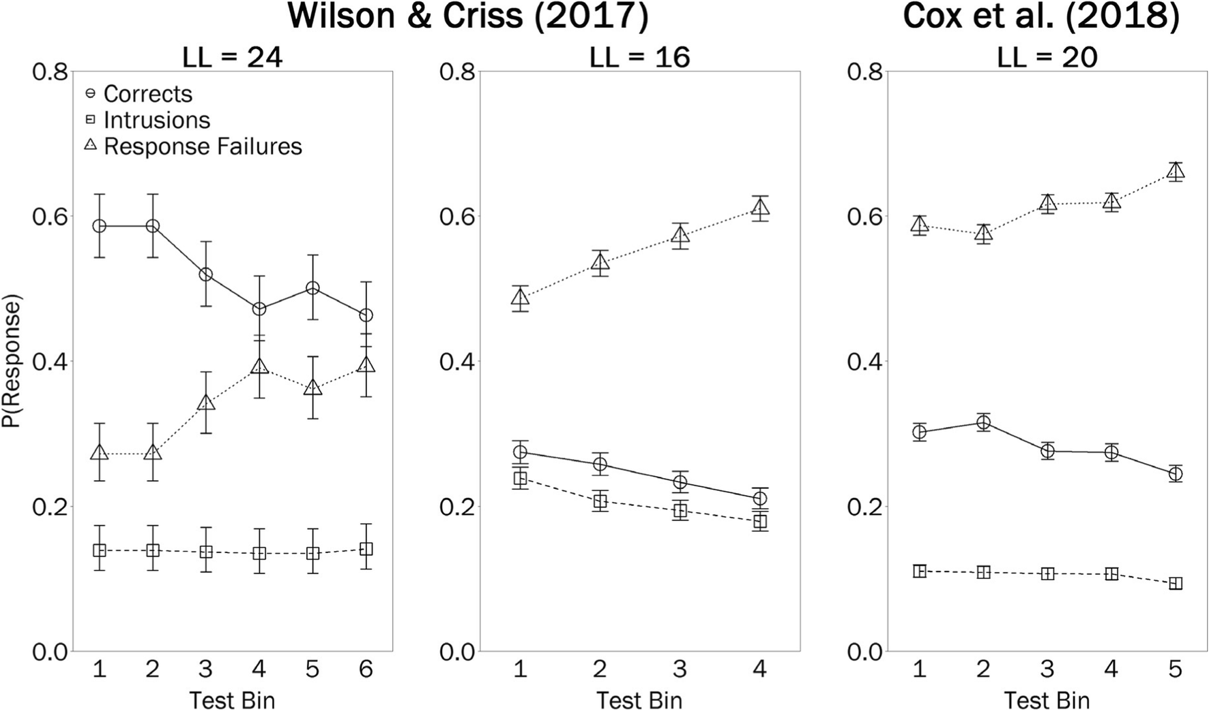
Output Interference
Output interference (OI) is a gradual decline in memory accuracy as a function of an item’s position in a testing sequence.
Errors of omission increase while errors of commission stay the same (Wilson et al., 2020).
Notes:
These are optional notes.

Slide 6
Mechanisms of OI
OI appears to result from the act of retrieval itself.
For example, Wilson et al. (2020) hypothesize the presence of a retrieval filter that limits the number of retrieval attempts.
Retrieval of items later in the recall sequence inhibited by retrieval of earlier items.
Repeated retrievals cause memory to reach maximum number of attempts before the target item or non-criterial information related to it can be accessed.
What is unknown is whether OI is a function of interference via spreading activation (i.e., a “Competition” account) or lack of access to criterial information altogether (i.e., a “Suppression” account).
Notes:
These are optional notes.

Slide 7
Memory Awareness
Metamemory judgments are sensitive to interference states, but to different degrees.
e.g., Eakin (2005), Diaz & Benjamin (2008)
Eakin & Hertzog (2012) found, for example, that prospective memory judgments for irretrievable items, known as feelings-of-knowing (FOKs), changed in magnitude, but not in accuracy, during implicit interference.
Likely reason: Non-criterial recollection, even during spreading activation
Sensitivity of metamemory judgments to interference states can help elucidate underlying mechanisms.
Notes:
These are optional notes.

Slide 8
Current Study
The current study used self-reported metamemory judgments to examine the mechanism underlying output interference during cued recall.
I use feelings-of-knowing (FOKs) and Remember/Know/No Memory (R/K/N) judgments to contrast two hypotheses:
Competition Hypothesis
Increases in “Know” judgements during OI, reflecting familiarity states during semantic competition.
Inhibition of target recall, but not of non-criterial information, during OI; similar FOK accuracy across trials.
Retrieval-suppression Hypothesis
Increases in rates of “No Memory” judgments during OI; no changes in “R” or “K”.
Occlusion of non-criterial recollection during OI, resulting in decreases in FOK accuracy across trials

Slide 9
METHODS

Slide 10
Participants
Sample consisted of 85 college-aged students recruited from Georgia Tech’s research subject pool.
Random (blind) assignment to 2 between-subjects conditions:
Related Cues
Unrelated Cues
CONDITION | N | M (age) | SE (age)
Related Cues | 49 | 20.24 | 0.57
Unrelated Cues | 36 | 19.73 | 0.25
Notes:
These are optional notes.

Slide 11
Conditions
Individuals in the Unrelated Cues condition studied lists of 40 completely unrelated cue-target word pairs.
Individuals in the Related Cues condition studied 4 lists of 10 cue-target word pairs where the cue words were categorically-related, but unrelated to the target words.
Cue words were selected from 10 exemplars from 4 normative taxonomic categories (Van Overschelde et al., 2004).
Example items:
Unrelated | Related
NEEDLE - QUESTION | RAIN - MIRAGE
OUTSIDE - LOST | SLEET - EAST
POST - FROWN | SNOW - PRECISE
PULL - CRISP | LIGHTNING - CIRCLE
Notes:
These are optional notes.

Slide 12
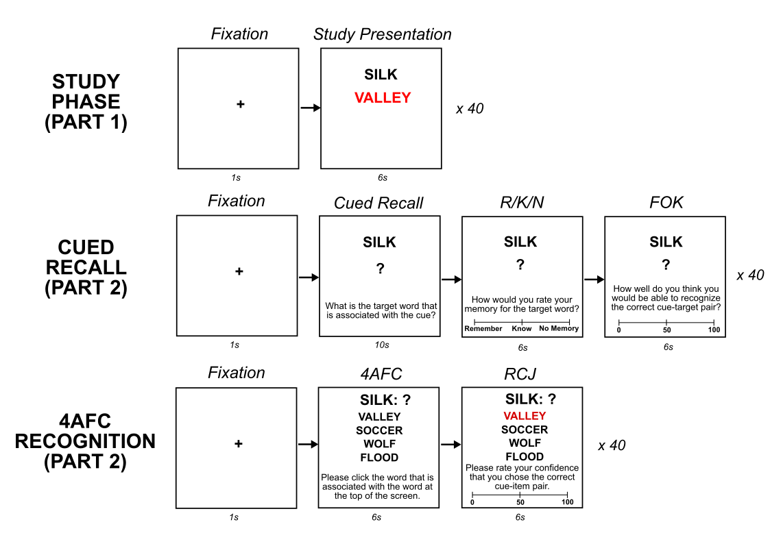
Procedure
Study
40 cue-target word pairs x 2.
Presented in random order.
Cued Recall
Cued recall attempt + R/K/N + FOK (0-100)
Related Cues: 4 blocks of 10 trials where cue words are from same category.
Unrelated Cues: 40 trials in random order.
Recognition
4AFC attempt + RCJ (0-100)
40 trials in random order.
Notes:
We presented the cue-target pairs twice (in 2 blocks) to bring recall accuracy off of floor.

Slide 13
RESULTS

Slide 14
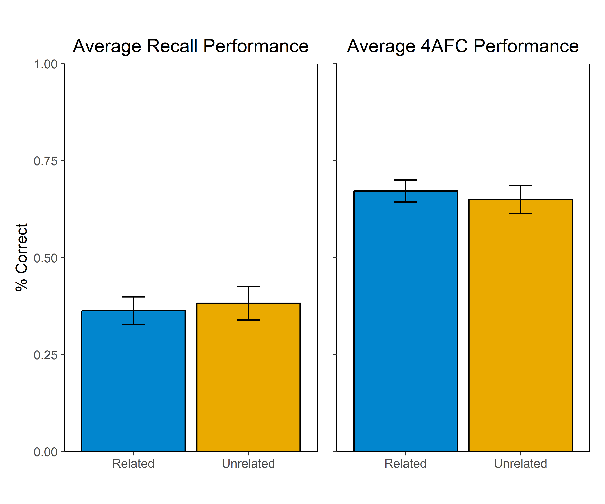
Memory Performance
Both conditions had similar overall levels of cued recall accuracy.
t(73.8) = 0.34, p = 0.73, d = 0.09
Both conditions also had similar 4AFC accuracy.
t(71.3) = 0.48, p = 0.64, d = 0.11
Notes:
Recog:
M_Related = 0.67, SE_Related = 0.03
M_Unrelated = 0.65, SE_Unrelated = 0.04
t(71.26) = 0.48, p = 0.64, d = 0.11.
Recall:
M_Related = 0.36, SE_Related = 0.04
M_Unrelated = 0.38, SE_Unrelated = 0.04
t(73.79) = 0.34, p = 0.73, d = 0.09.

Slide 15
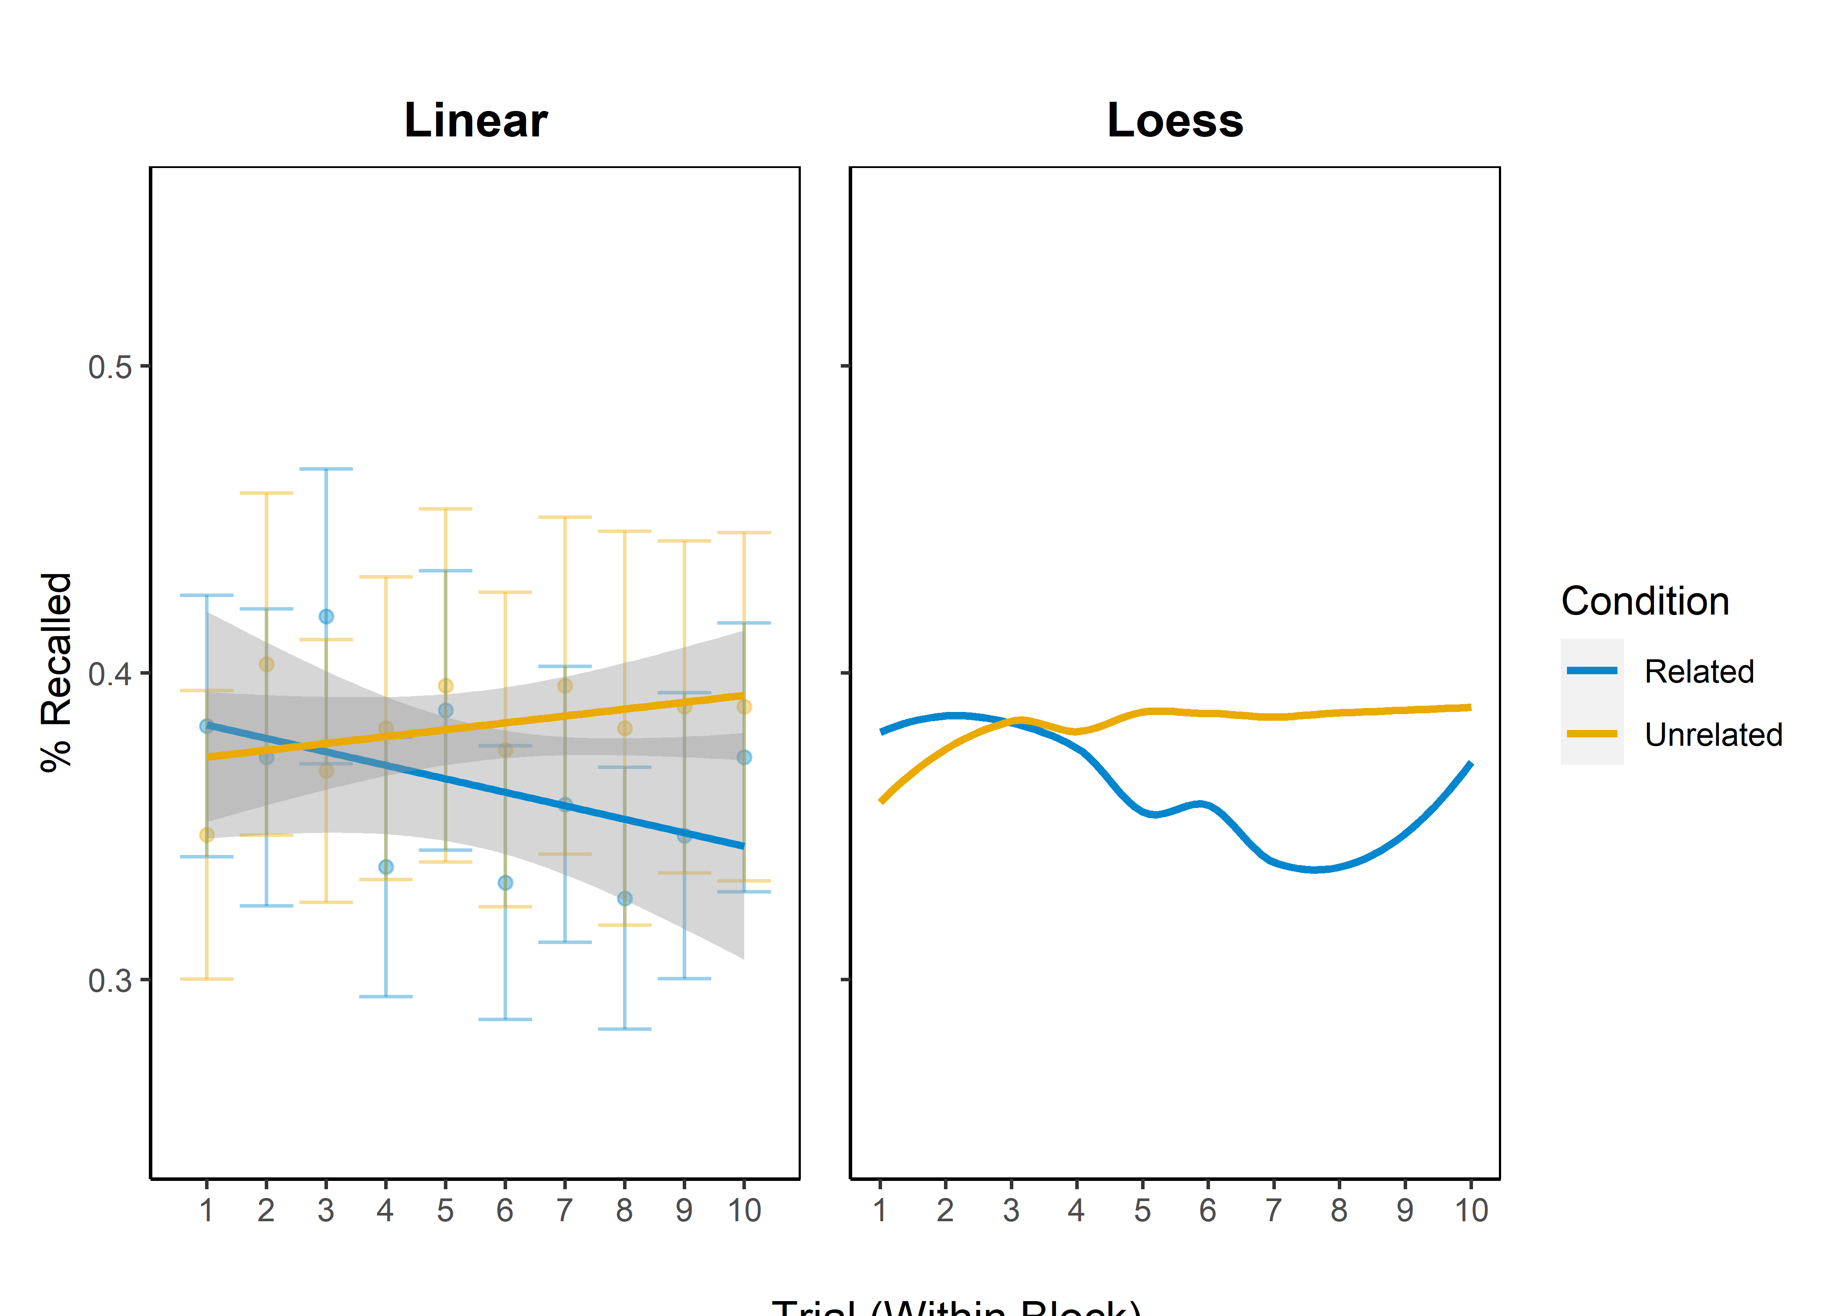
Recall Across Trials
Cued recall accuracy decreases across trials (within blocks), but only for those in the Related Cues condition.
Notes:
Output of random-intercepts MLM:
Intercept: b = -0.6, SE = 0.22, z = -2.74, p = 0.01
Condition (Unrelated): b = -0.15, SE = 0.34, z = -0.45, p = 0.65
Trial (within cycle): b = -0.03, SE = 0.02, z = -1.35, p = 0.18
Condition (Unrelated) x Trial: b = 0.04, SE = 0.03, z = 1.32, p = 0.19

Slide 16
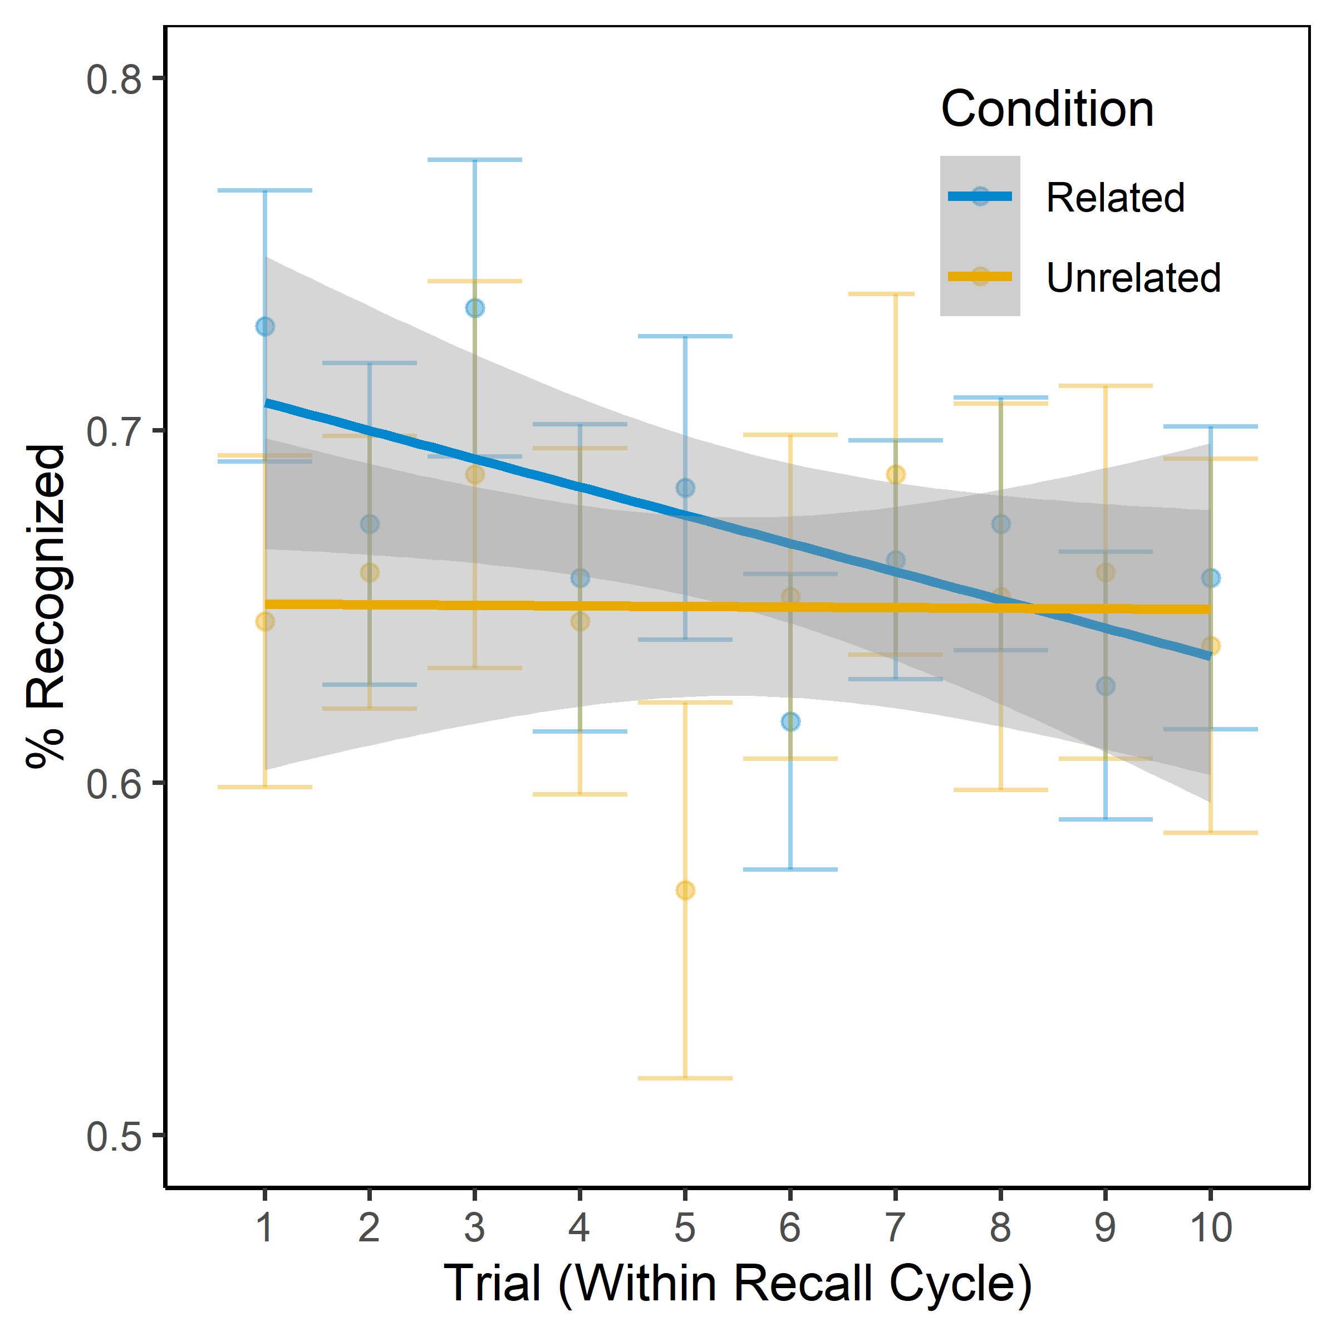
4AFC Across Recall Trials
Interestingly, recognition performance shows similar decreases in the Related Cues condition when 4AFC accuracy is back-sorted to align with recall trials.
Notes:
Output of random-intercepts MLM:
Intercept: b = 1.12, SE = 0.19, z = 5.99, p < 0.05
Condition (Unrelated): b = -0.35, SE = 0.29, z = -1.21, p = 0.23
Trial (within cycle): b = -0.04, SE = 0.02, z = -2.37, p = 0.02
Condition (Unrelated) x Trial: b = 0.04, SE = 0.03, z = 1.52, p = 0.13

Slide 17
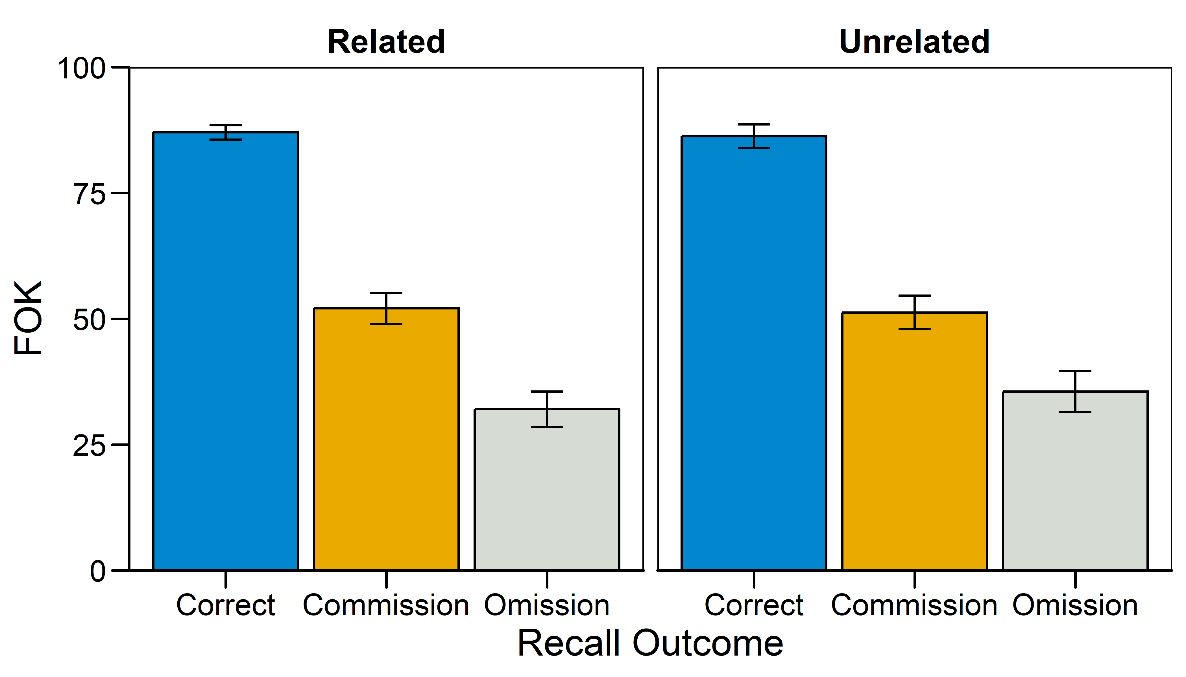
Mean FOKs by Recall Outcome
No differences in FOK judgment magnitude between conditions.
Notes:
Mixed-effects ANOVA:
Condition: F(1,68) = 0.10, p = 0.92, pes < 0.01
Recall Outcome: F(2,136) = 242.54, p < 0.05, pes = 0.78
Condition x Outcome: F(2,136) = 0.51. p = 0.60, pes < 0.01
Means:
Related: M_Correct = 87.03, SE_correct = 1.43, M_Comm = 52.06, SE_Comm = 3.11, M_Om = 32.02, SE_Om = 3.49
Unrelated: M_Correct = 86.25, SE_correct = 2.35, M_Comm = 51.25, SE_Comm = 3.36, M_Om = 35.55, SE_Om = 4.08

Slide 18
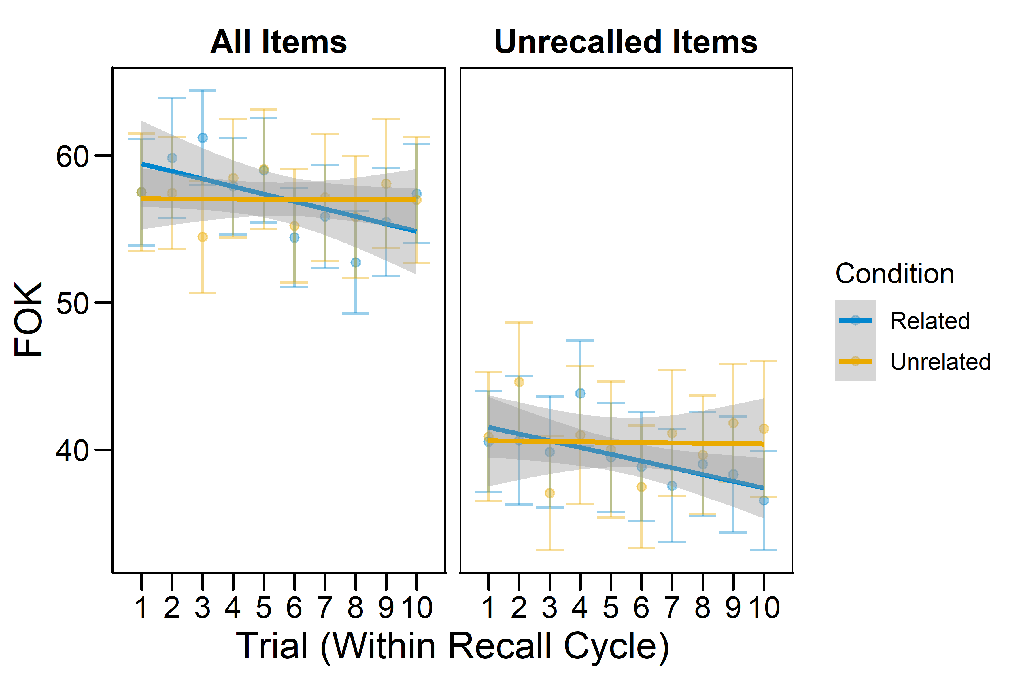
Mean FOKs Across Trials
FOKs decrease across trials (within blocks), but only for participants in the Related Cues condition.
Notes:
Random-intercepts MLM:
Condition: F(1,172.1) = 0.83, p = 0.36
Recall: F(1,3180.3) = 562.67, p < 0.05
Trial (within Cycle): F(1,3151.3) = 3.07, p = 0.08
Condition x Recall: F(1,3180.3) = 0.47, p = 0.49
Condition x Trial: F(1,3151.3) = 3.19, p = 0.07
Recall x Trial: F(1,3155.4) < 0.01, p = 0.97
Condition x Recall x Trial: F(1,3155.4) = 2.32, p = 0.13
Simple slopes from 3-way interaction:
Related, Unrecalled: b = -0.64, SE = 0.24, t = -2.70, p < 0.05
Related, Recalled: b = -0.21, SE = 0.30, t = -0.68, p = 0.49
Unrelated, Unrecalled: b = 0.01, SE = 0.27, t = 0.02, p = 0.98
Unrelated, Recalled: b = -0.46, SE = 0.35, t = -1.31, p = 0.19

Slide 19
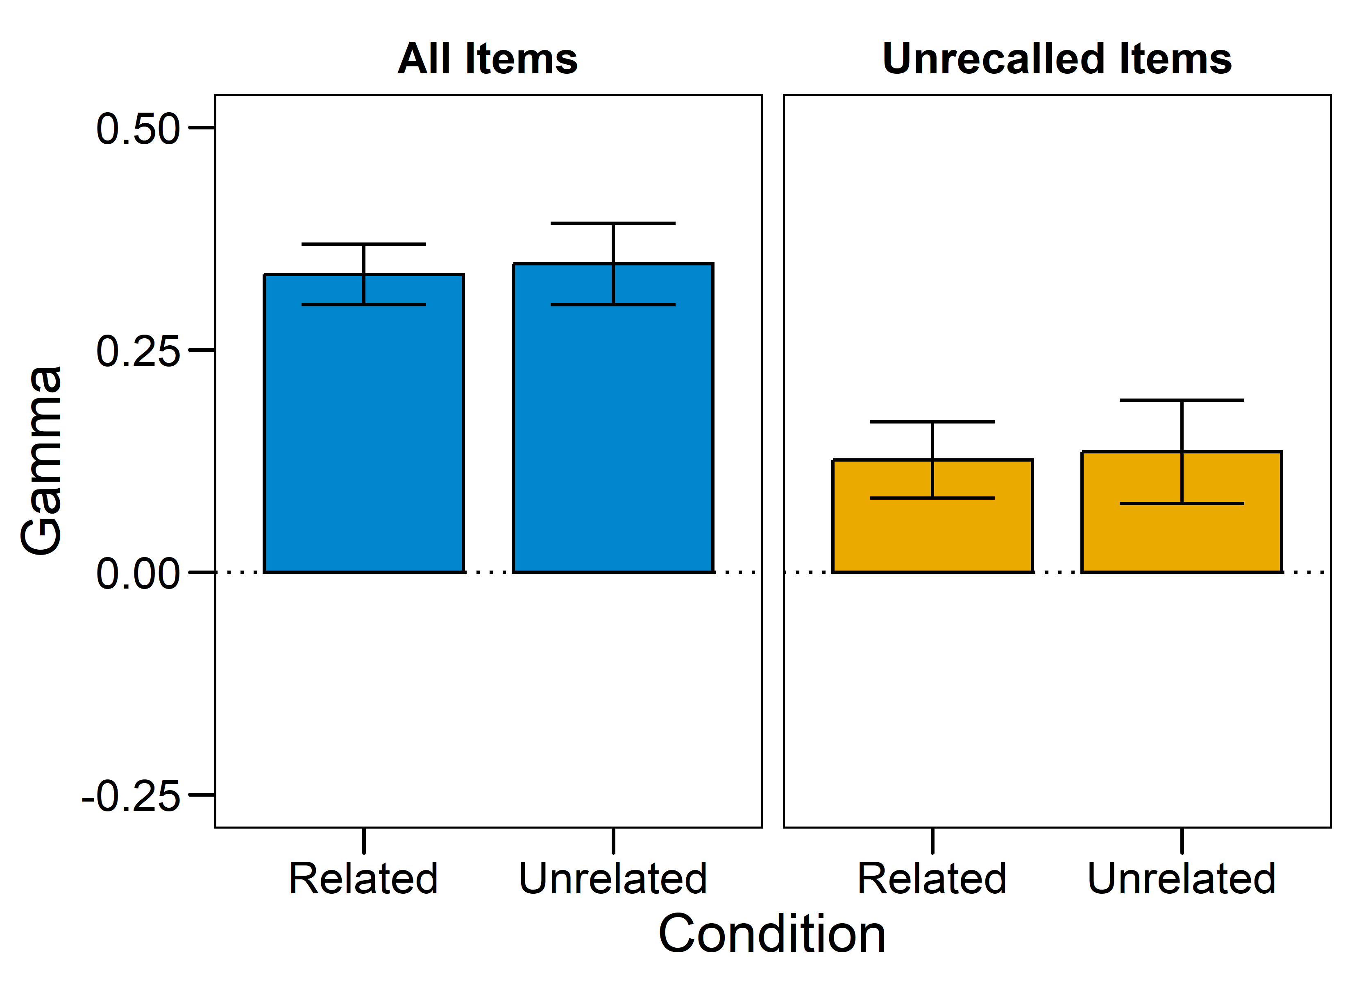
Mean FOK x 4AFC Gammas
FOKs share a weak relationship with recognition outcomes in both conditions.
Notes:
All items:
M_Related = 0.33, SE_Related = 0.03
M_Unrelated = 0.35, SE_Unrelated = 0.05
t(69.05) = -0.20, p = 0.84, d = 0.05
Unrecalled items:
M_Related = 0.13, SE_Related = 0.04
M_Unrelated = 0.14, SE_Unrelated = 0.06
t(64.56) = -0.13, p = 0.90, d = 0.03

Slide 20
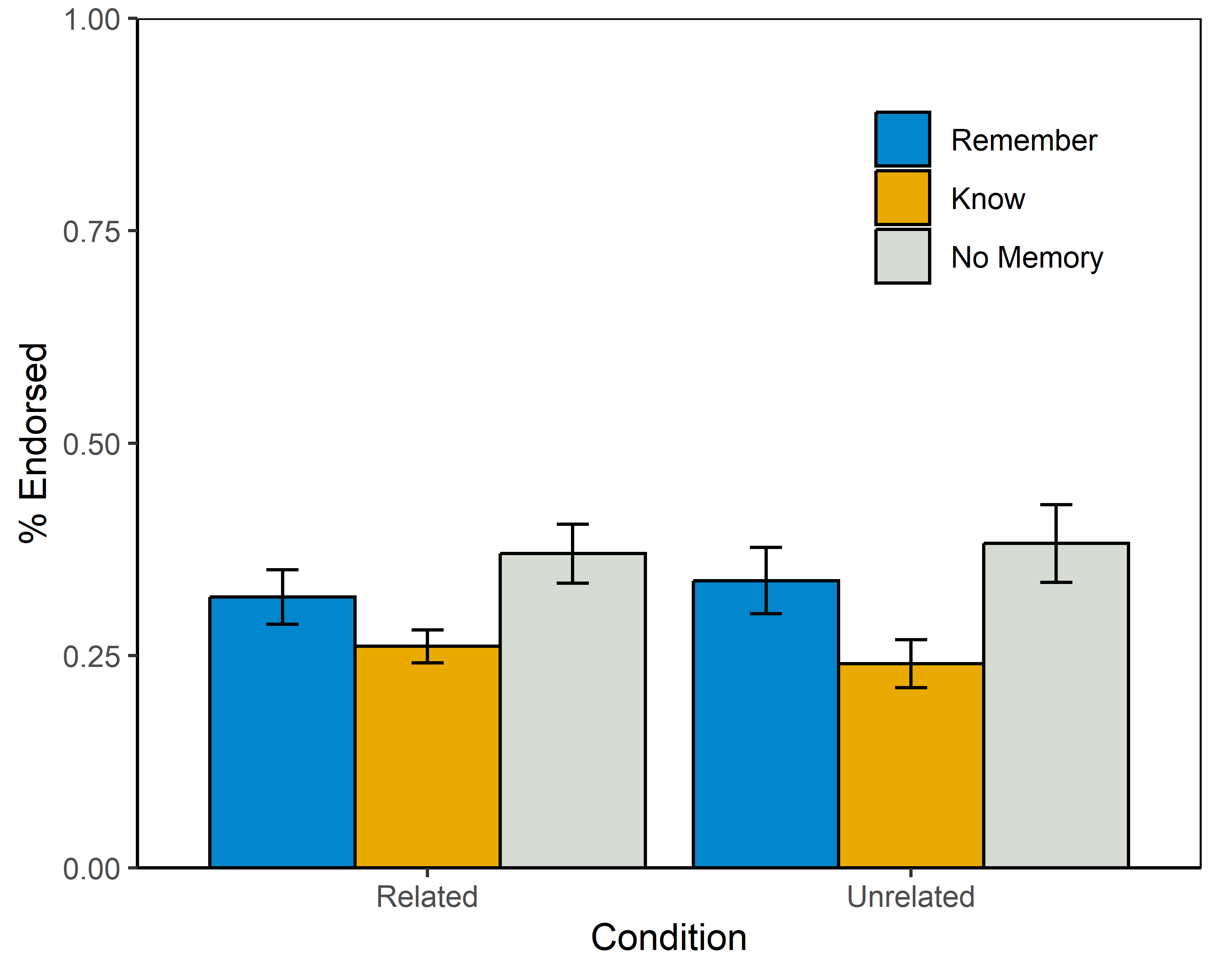
R/K/N Rates by Condition
Participants in both conditions gave similar numbers of R/K/N judgments, but with different effects (next slide).
Notes:
ME ANOVA w/ DF correction using Huyhn-Feldt
Condition: F(1,83) = 0.26, p = 0.61, pes < 0.01
Rating: F(1.62,134.55) = 4.85, p = 0.01, pes = 0.06
Condition x Rating: F(1.62,134.55) = 0.14, p = 0.83, pes < 0.01

Slide 21
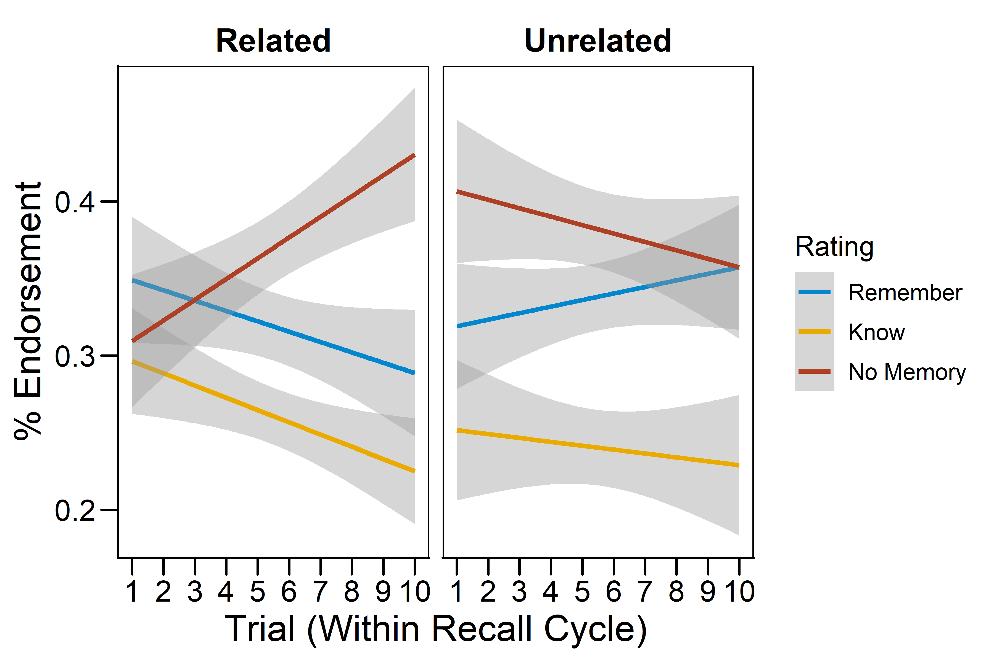
R/K/N Rates Across Trials
During OI, self-reported recollection and familiarity decrease while states of not knowing increase.
In the control condition, “Remember” rates increase, “No Memory” rates decrease, and “Know” rates do not change.
Notes:
Multinomial logistic regression output. The coefficients are log-odds against the reference group (Related Cues, “Remember”).
KNOW:
Intercept: b = -0.151, z = -1.01, p = 0.23
Condition (Unrelated): b = -0.064, z = -0.33, p = 0.74
Trial (within cycle): b < -0.01, z = -0.46, p = 0.65
Condition x Trial: b = -0.013, z = -0.42, p = 0.68
NO MEMORY:
Intercept: b = -0.173, z = -1.21, p = 0.23
Condition (Unrelated): b = 0.441, z = 2.46, p = 0.01
Trial (within cycle): b = 0.058, z = 3.02, p < 0.01
Condition x Trial: b = -0.084, z = -2.93, p < 0.01

Slide 22
CONCLUSIONS

Slide 23
Conclusions
Evidence for a retrieval-suppression account of OI is mixed.
On the one hand, cued recall decreases while “No Memory” judgments increase during OI, consistent with this account.
On the other, FOKs change only in magnitude and not accuracy during OI, consistent with a semantic competition Account.
Interestingly, effects of OI during cued recall carried over to recognition performance.
4AFC accuracy decreases across blocked recall trials.
Feelings-of-knowing show sensitivity to the degree of interference during recall.
FOKs decrease in magnitude across trials during OI, even when examining only unrecalled items.
No commensurate changes in FOK accuracy.

Slide 24
Future Work
Correspondence between OI during recall and subsequent 4AFC performance was unexpected.
Future experiments will need to control OI during recall, but not recognition, to examine sensitivity of FOKs.
Higher baseline cued-recall accuracy may be needed to fully examine OI effects.
Nevertheless, metamemory judgments are useful for examining + validating mechanistic accounts of episodic memory phenomena.

Slide 25
THANK YOU!
References
Anderson, M. C., & Neely, J. H. (1996). Interference and inhibition in memory retrieval. In E. L. Bjork & R. A. Bjork (Eds.), Memory (pp. 237–313). Elsevier.
Diaz, M., & Benjamin, A. S. (2011). The effects of proactive interference (PI) and release from PI on judgments of learning. Memory & Cognition, 39(2), 196–203.
Eakin, D. K. (2005). Illusions of knowing: Metamemory and memory under conditions of retroactive interference. Journal of Memory and Language, 52(4), 526–534.
Eakin, D. K., & Hertzog, C. (2012). Age invariance in feeling of knowing during implicit interference effects. Journals of Gerontology Series B: Psychological Sciences and Social Sciences, 67(5), 555–562.
Nelson, D. L., McKinney, V. M., Gee, N. R., & Janczura, G. A. (1998). Interpreting the influence of implicitly activated memories on recall and recognition. Psychological Review, 105(2), 299–324.
Postman, L., Stark, K., & Fraser, J. (1968). Temporal changes in interference. Journal of Verbal Learning and Verbal Behavior, 7(3), 672–694.
Tulving, E., & Watkins, M. J. (1974). On negative transfer: Effects of testing one list on the recall of another. Journal of Verbal Learning and Verbal Behavior, 13(2), 181-193.
Wilson, J. H., Kellen, D., & Criss, A. H. (2020). Mechanisms of output interference in cued recall. Memory & Cognition, 48(1), 51–68.

Slide 26
APPENDIX

Slide 27
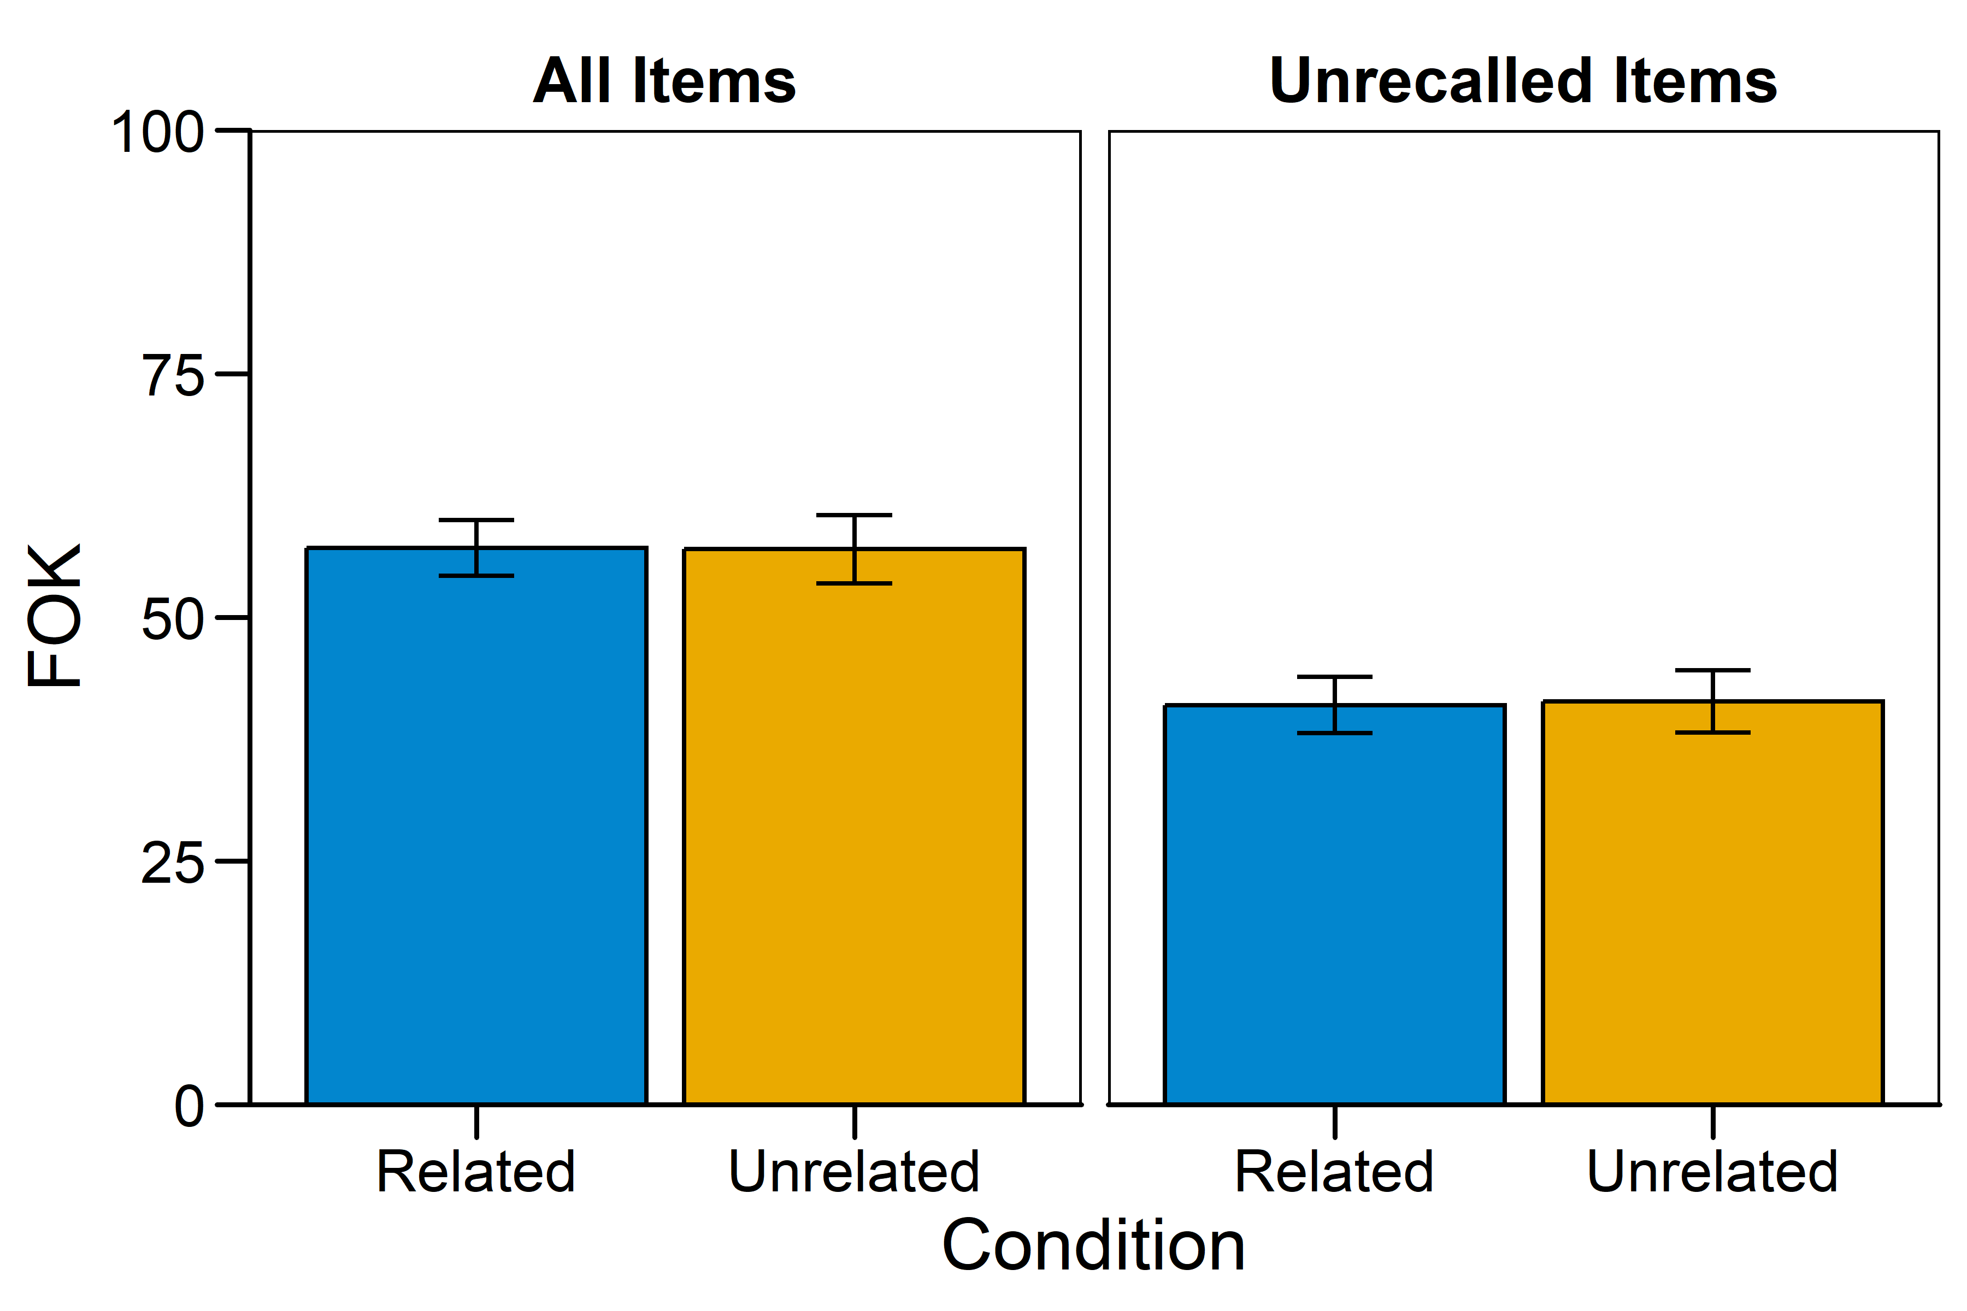
Mean FOKs
No differences in FOK judgment magnitude between conditions.
Notes:
All items:
M_Related = 57.12, SE_Related = 2.88
M_Unrelated = 56.98, SE_Unrelated = 56.98
t(74.04) = 0.03, p = 0.98, d < 0.01
Unrecalled items:
M_Related = 40.98, SE_Related = 2.89
M_Unrelated = 41.65, SE_Unrelated = 3.20
t(77.58) = -0.08, p = 0.93, d = -0.02

Slide 28
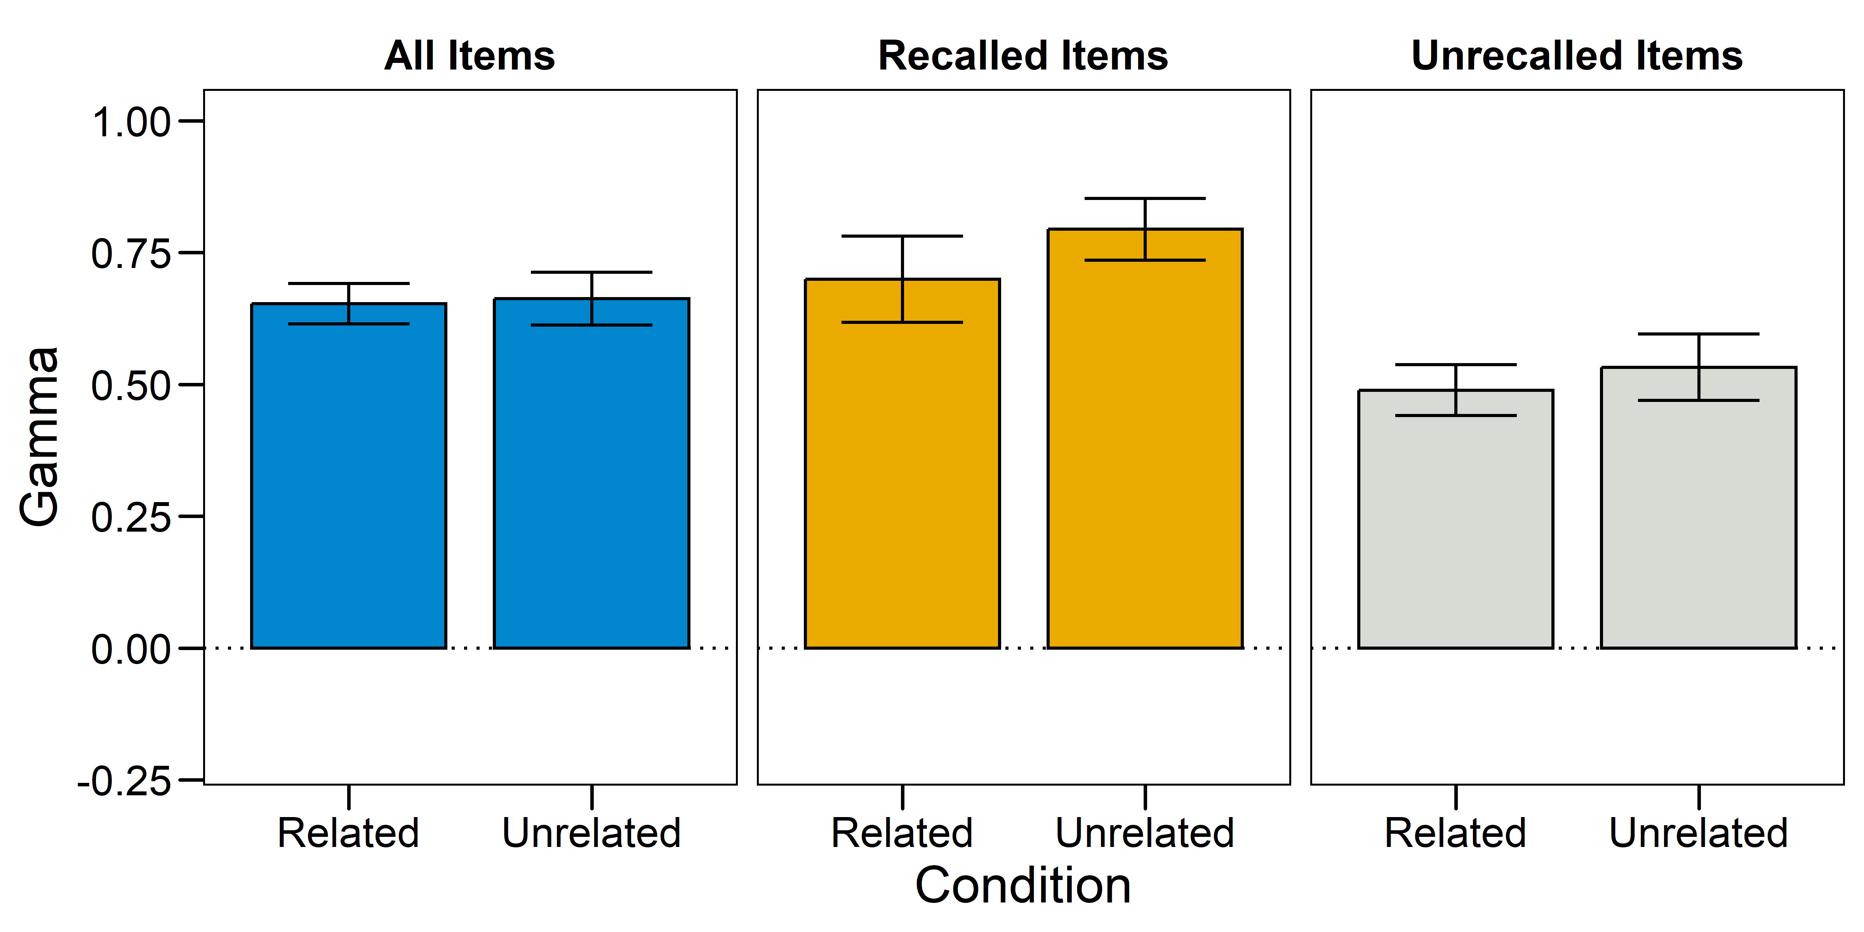
Mean RCJ x 4AFC Gammas
RCJs are moderately predictive of performance during 4AFC.
Notes:
All items:
M_Related = 0.65, SE_Related = 0.04
M_Unrelated = 0.66, SE_Unrelated = 0.05
t(70.30) = -0.15, p = 88, d = 0.03
Unrecalled items:
M_Related = 0.49, SE_Related = 0.05
M_Unrelated = 0.53, SE_Unrelated = 0.06
t(66.52) = -0.53, p = 0.59, d = 0.12

Slide 29
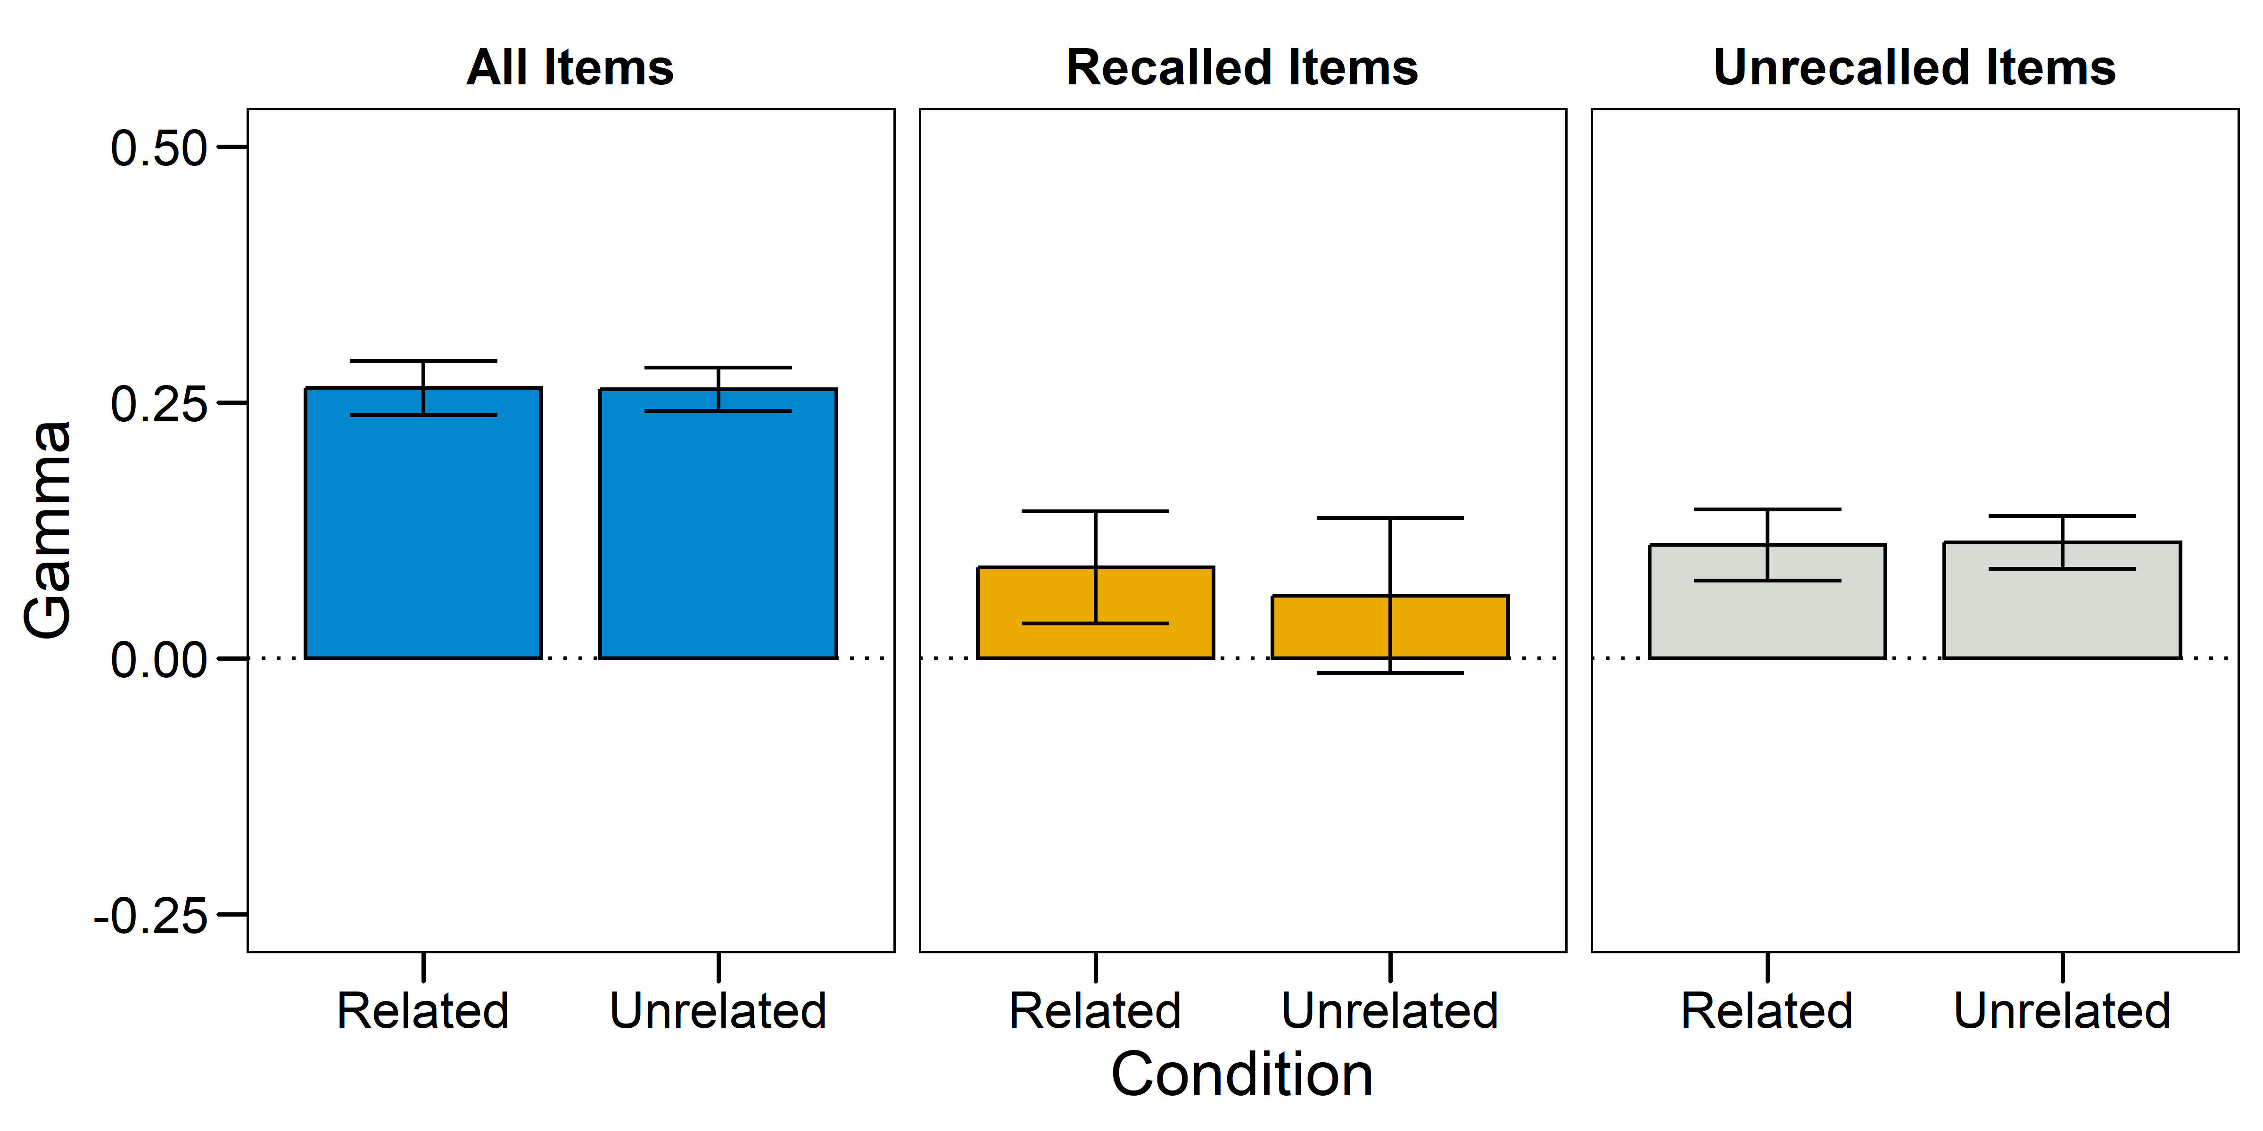
Mean FOK x RCJ Gammas
Judgments made about recognition after a recall attempt share little relationship with confidence judgments given after recognition.
Notes:
All items:
M_Related = 0.26, SE_Related = 0.03
M_Unrelated = 0.26, SE_Unrelated = 0.02
t(82.70) = 0.03, p = 0.98, d < 0.01
Unrecalled items:
M_Related = , SE_Related =
M_Unrelated = , SE_Unrelated =
t() = , p = , d =

Slide 30
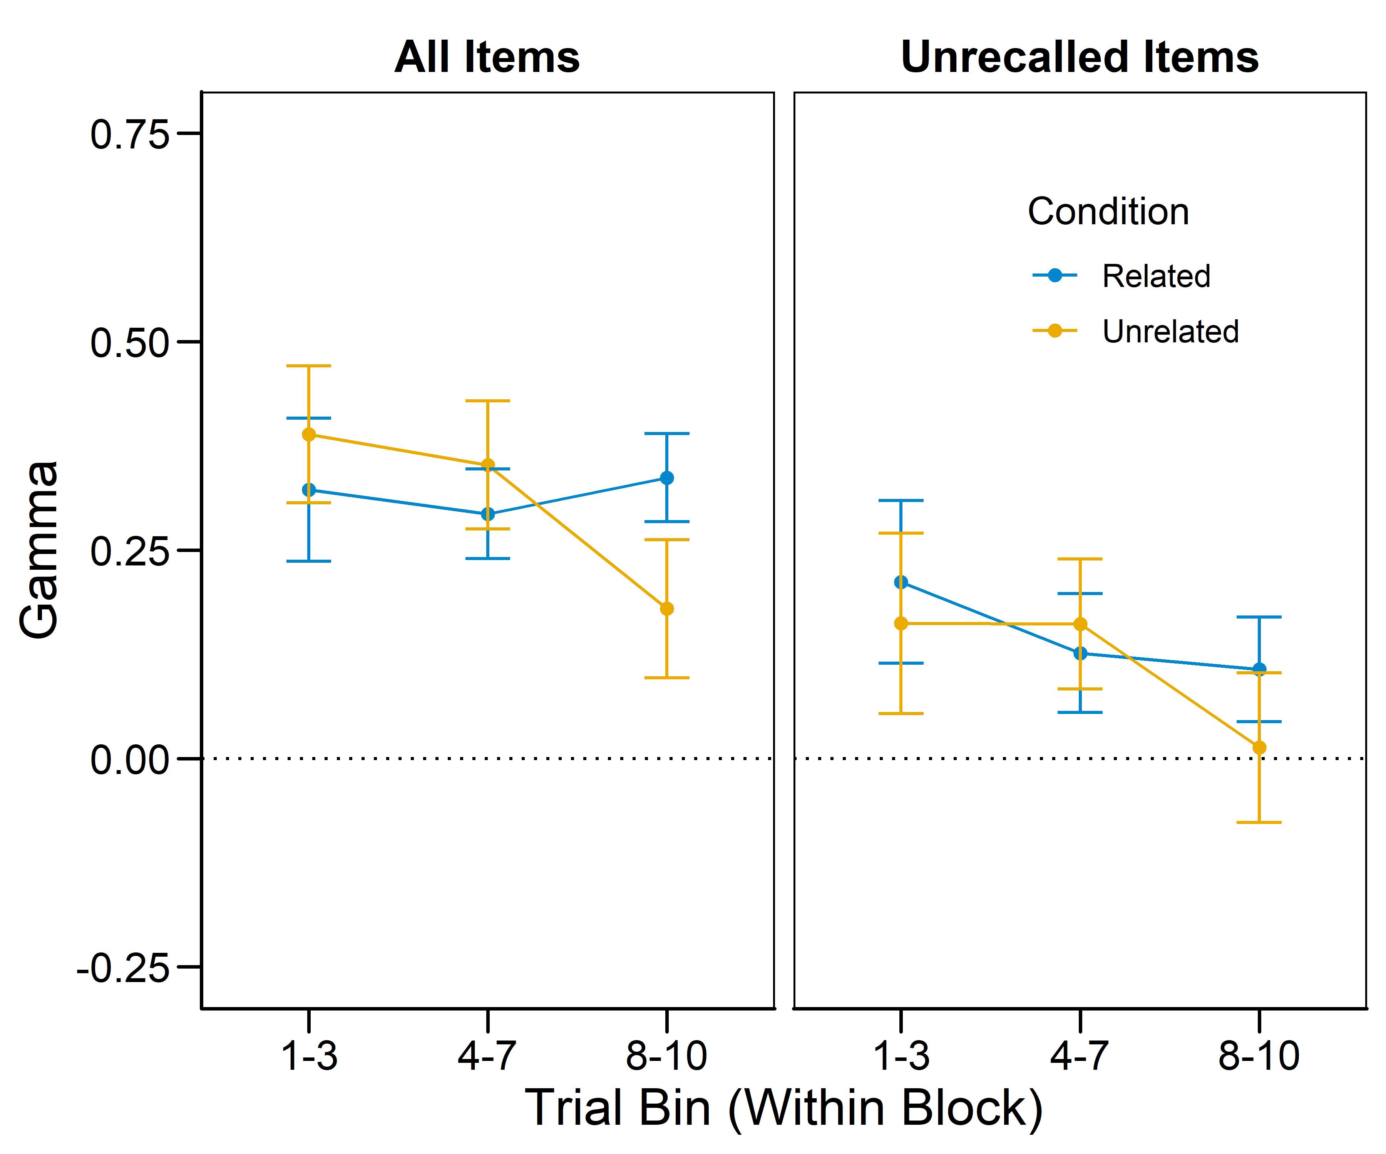
Within-bin FOK x 4AFC Gammas
Notes:
These are optional notes.

Slide 31
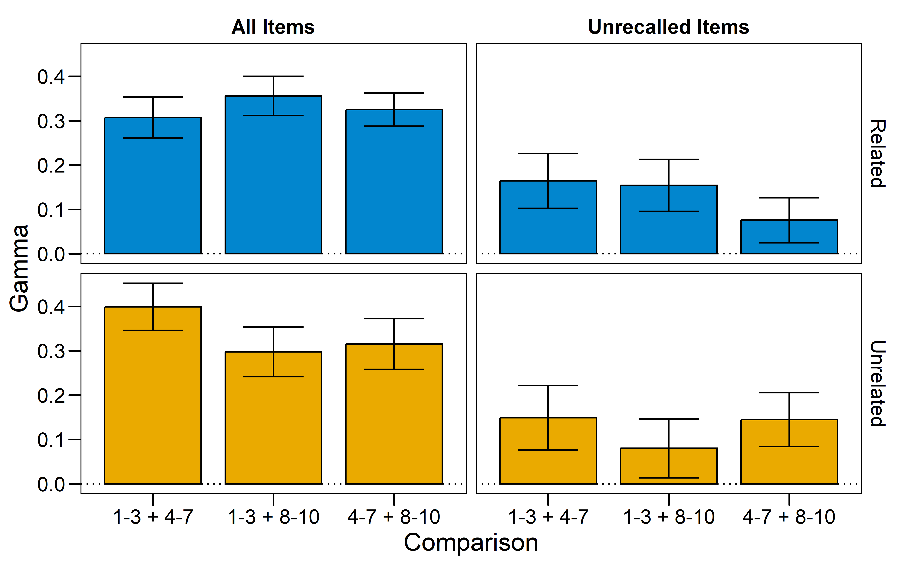
Part-set FOK x 4AFC Gammas
Notes:
These are optional notes.

Slide 32
Mechanisms of OI
Most accounts of interference implicate the roles of spreading activation and competition.
E.g., Nelson et al. (1998)
OI, however, seems to result from the act of retrieval itself.
For example, Anderson and Neely (1996, p. 270) observe that OI “violate[s] the widely held idea... that interference is initiated by competition for a shared retrieval cue“.
Notes:
These are optional notes.

